Slide 1
Difference between Talend Open Studio and Talend Enterprise version
February 15, 2018
Presenter:

Slide 2
Support and Documentation
Topics | Talend Open Studio for Data Integration | Talend Integration Studio for Data Integration
Community-based: forums, Bugtracker | YES | YES
User Guide and Reference Guide | YES | YES
Enterprise grade support with SLAs | NO | YES
Talend Forum , Exchange & Bug tracker:
http://www.talendforge.org/forum/
http://www.talendforge.org/exchange/index.php
http://www.talendforge.org/bugs/
Talend Documentaion: https://help.talend.com/display/HOME/Talend+Open+Studio+for+Data+Integration

Slide 3
Support and Documentation
Community-Based: Forums, Bugtracker The Talend user community, composed of tens of thousands of professionals, is extremely active. The main contributions of the community include:
• Testing and the quality of new versions, • Requests for new features, • Product translation and localization, • Support and exchanges via the forums, • Development and sharing of new components, connectors, jobs, models and other plug-ins.
User Guide, Reference Guide
The documentation of Talend is available as free download in PDF format, in English and French. Two guides, the User Guide and the Components Reference Guide are available at: https://help.talend.com/display/HOME/Talend+Open+Studio+for+Data+Integration
Enterprise grade support with SLAs
By subscribing to Talend Support Services, one benefit from the experience of their in-house technical experts, who are daily in touch with our R&D Team Edition. These services were established to insure effectiveness, security, and peace of mind of our subscription customers. They are available in three levels: Silver, Gold and Platinum.

Slide 4
Implementation
Topics | Talend Open Studio for Data Integration | Talend Integration Studio for Data Integration
Job Designer | YES | YES
Components | YES | YES
ETL & ELT modules | YES | YES
Versioning | YES | YES
Shared Repository | NO | YES
Data Viewer | NO | YES
Dynamic Schema | NO | YES
Impact Analysis and Data Lineage | NO | YES
Job Compare | NO | YES
Joblets | NO | YES
Change Data Capture | NO | YES
Business Rules | NO | YES

Slide 5
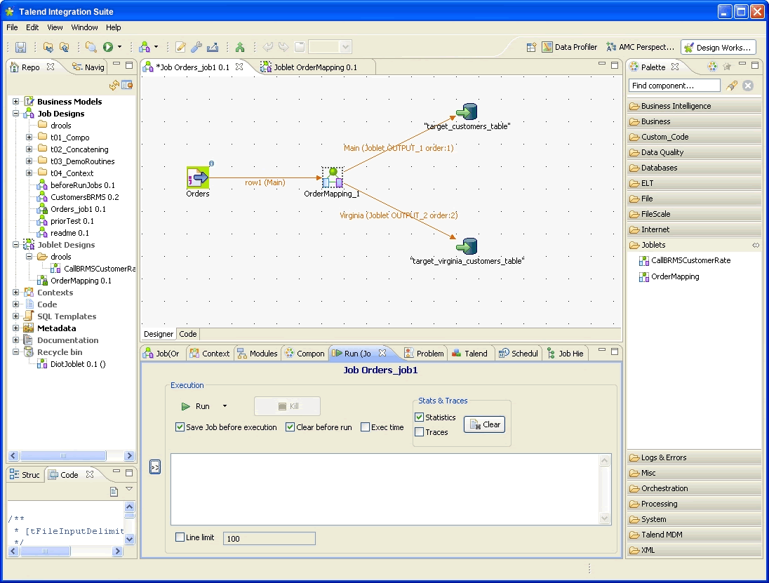
Implementation…..
The Job Designer provides both a graphical and a functional view of the actual integration processes using a graphical palette of components and connectors. Integration processes are built by simply dragging and dropping the components and connectors onto a graphical workspace, drawing connections and relationships between them, and setting their properties.

Slide 6
Implementation…..
Components - Talend offers native technical and business open source connectors to access all IT environments. This wide array of ever-expanding connectors is the key to the successful interoperability of applications and databases. It allows bridging diverse and heterogeneous data structures at unmatched performance rates. More than 800 components are available, free of charge, 60% of which are designed and developed by the Talend community.
ETL (Extract, Transform & Load) is the default mode used by Talend's data integration solutions. It consists in processing data rows one right after the other in a flow mode. This mode is specifically adapted for heterogeneous environments and it enables the integration of any technology in the source and target systems (web service, files, databases, MOM, business applications, etc.). ETL mode can also be used in both batch and real time processing. The ETL processes can be run in parallel to further accelerate their execution.
ELT - Talend's data integration solutions also support ELT mode (Extract, Load & Transform for processing data in a set operation (using the Union, Except and Intersect operators) directly on the DBMS of the target database. This mode is for use in a homogeneous environment (one database) and has advantages for processing very large volumes of data in "data warehouse appliance" environments like Teradata, Netezza, etc.

Slide 7
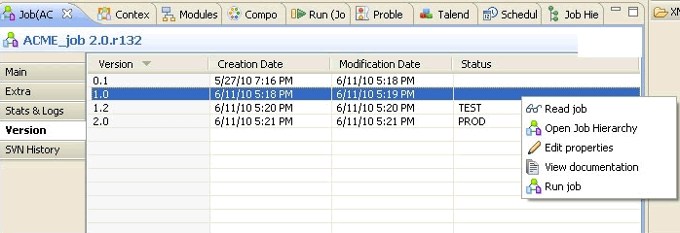
Implementation…..
Versioning - Talend Open Studio simplifies versioning of items. Versioning best practices facilitate item reusability and simplify reverting to a previous development stage.
A major and minor version number is automatically set at Job creation, and can then be easily incremented over time and when updates occur by using the dedicated version control panel available directly in the Designer perspective. All items created in Studio can be versioned: Jobs, Routines, Metadata, and Documentation.

Slide 8
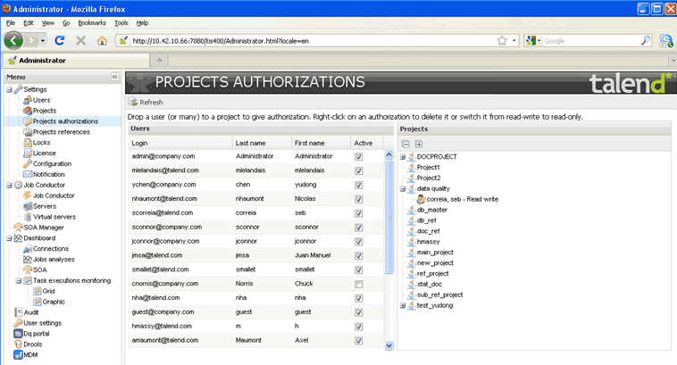
Implementation…..
The Shared Repository (or Metadata Manager) is designed to consolidate all project information and enterprise metadata in a centralized repository shared by all stakeholders in the integration processes. It helps to store and share all Talend items including: Business Models, Jobs (processes), Joblets, Routines, Metadata definitions (such as connections to source/target systems). Studio users are granted access to projects according to their roles and permissions defined in Talend Administration Center.

Slide 9
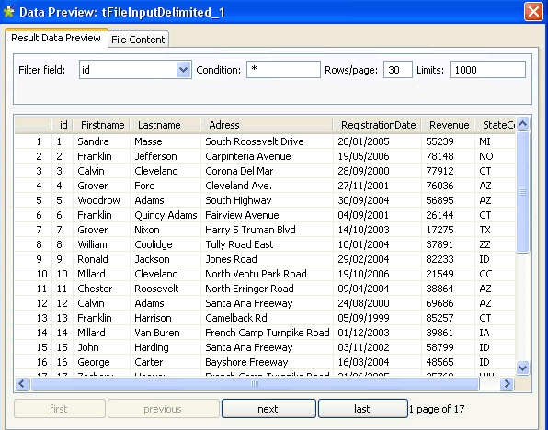
Implementation…..
Data Viewer - While developing jobs with Talend you may need to view the content of various source or target systems (files, DB, etc). The Data Viewer is directly accessible within the Studio through a simple right-click on any component. It is a convenient way to view data contained in your source/target systems regardless of their format (Excel, DB table, CSV...) while you are developing your integration processes.

Slide 10
Implementation…..
Dynamic schemas allow the designing of jobs with an unknown column structure and number. Depending on the choice of the developer, dynamic columns can be mapped directly to the target using pass-through mode. Dynamic schemas makes designing certain types of jobs easy, such as a replication scenario, simple one-to-one mapping of many columns, or when you need to migrate a whole database with hundreds of tables without knowing all of the table structures.
Impact Analysis - Helps to identify all the Jobs that use any of the items centralized in the Repository tree view and that will be impacted by a change in the parameters of a repository item. Impact analysis also analyzes the data flow in each of the listed Jobs to show all the components and stages the data flow passes through and the transformation done on data from the source component up to the target component.
The Data Lineage feature helps you understand where a change occurred. This feature is available from the Metadata Manager and can be carried out on any column of any metadata (DB, file). The result of the data lineage shows in a report which traces a change from the target end component of a Job up to the source end.

Slide 11
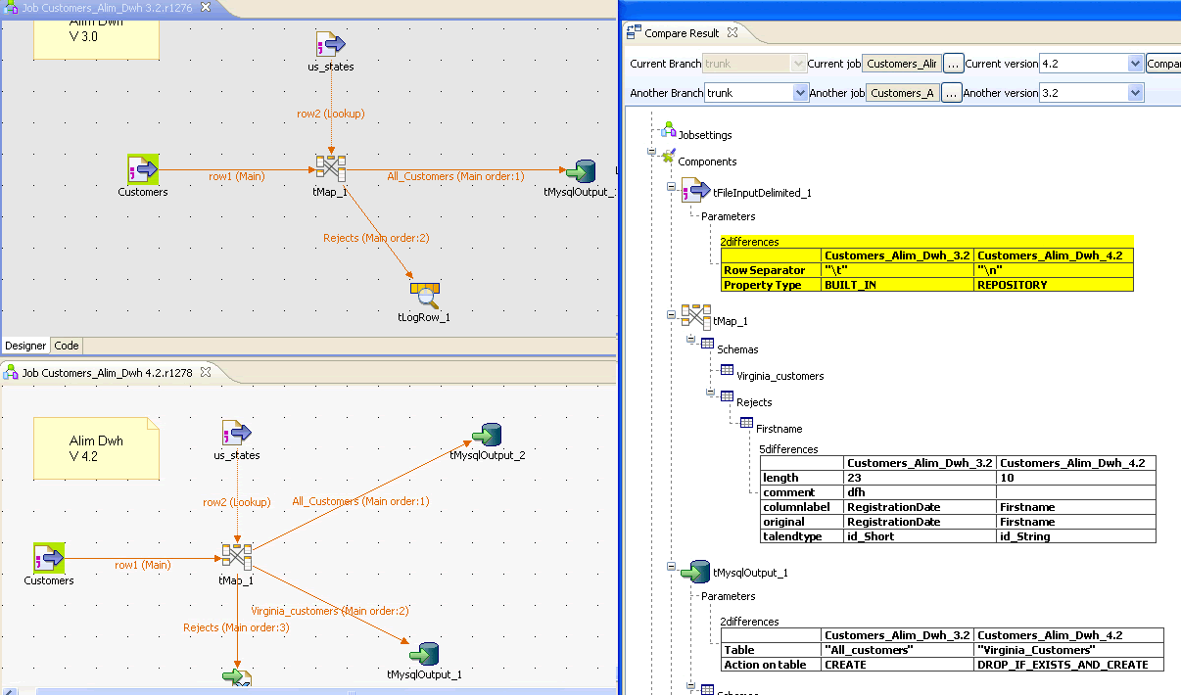
Implementation…..
The Job Compare

Slide 12
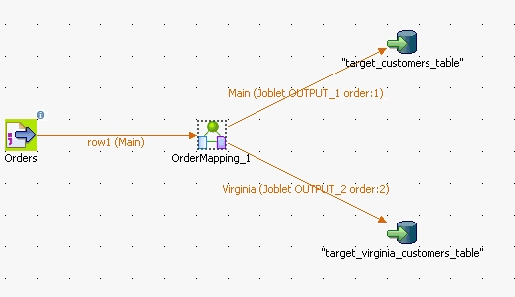
Implementation…..
Joblets help you factorize a job part (or Subjob) into a Joblet component. Simply select the components forming the Job part you need to reuse or want to factorize and click on the "Refactor to Joblet" menu item. Automatically, the job design gets simplified, as the selected components are collapsed into a single Joblet component. This Joblet component can be shared through the dedicated Joblets folder in the Palette of components and is thus easily reusable in any other Job. Joblets drastically simplify the maintenance of redundant and complex jobs.

Slide 13
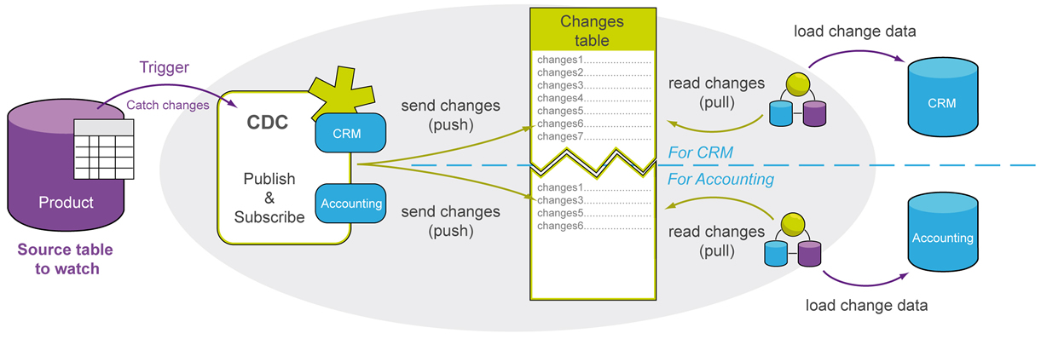
Implementation…..
Change Data Capture - The ability to capture only the changed data in real time is known as Change Data Capture (CDC). Capturing changes reduces the traffic of data between systems and helps reduce ETL time. Talend CDC architecture is based on a publisher/subscriber model. The publisher captures the data changes and makes them available to the subscribers (Talend Jobs). Subscribers utilize the data changes obtained from the publisher.

Slide 14
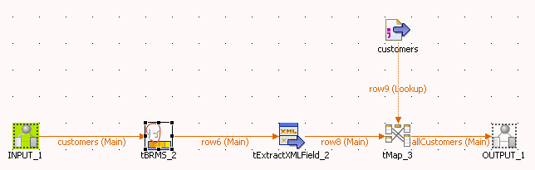
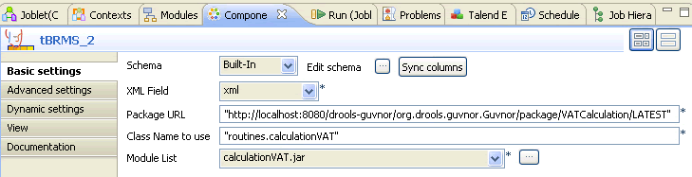
Implementation…..
Business rules are generally defined by business users through specification documents which are then interpreted and implemented by technical staff. Talend Enterprise Data Integration embeds a business rule engine that helps users configure their own business rules. Users can thus define market segmentation criteria (by age, region...) and set their business rules via an Excel spreadsheet or interface directly the web-based Talend Administration Center.

Slide 15
Deployment
Topics | Talend Open Studio for Data Integration | Talend Integration Studio for Data Integration
Talend Administration Center | NO | YES
Job Conductor | NO | YES
Command Line | NO | YES
Time Scheduler | NO | YES
Event Scheduler | NO | YES
Execution Plan | NO | YES
Hadoop | YES | YES
Copyright © 2014 by Vikram Takkar. All Rights Reserved..

Slide 16
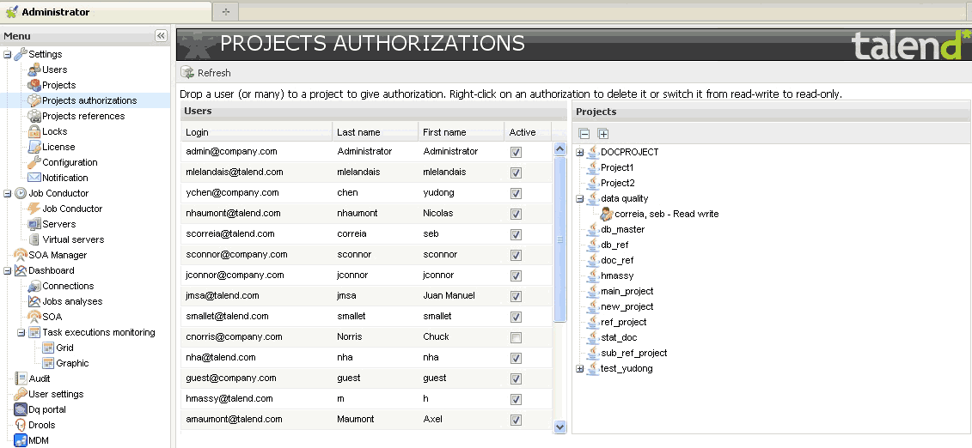
Deployment ….
Talend Administration Center is a lightweight application (in a browser, no deployment needed) that helps integration project
managers to administrate users, projects, user privilege, license...
Copyright © 2014 by Vikram Takkar. All Rights Reserved..

Slide 17
Deployment ….
The Job conductor coordinates the execution of data integration jobs. It provides a centralized execution interface from which all jobs can be started upon request or according to time-based (from Team Edition) or event-based (from Professional Edition) schedules. Job conductor allows you to monitor, in real time, all your hardware resources (available CPU, RAM, HD...) helping you distributing job executions over the grid, based on the best available server.
Talend Command Line module provides a set of command line options that allow developers and administrators to easily perform batch operations. Nearly all Job management functions offered through the Talend Studio and the Talend Administration Center are also available through the Command Line. This includes for example functions like: updating Job properties, promoting projects to production, exporting/importing Jobs or sets of Jobs, etc. The Command Line feature makes it easy and quick to roll out numerous and complex Job deployments and executions including their dependencies and execution metadata.

Slide 18
Deployment ….
The Time-based scheduler helps you roll-out a job execution at a defined time and date (first Monday of the month, every Tuesday...) or on a regular basis, over a period of time. A Task is used to centralize all information necessary for the job execution (project name, job name, job version, server...) The task is then triggered upon schedule and the job is thus deployed & executed automatically onto the defined server at the defined time. A convenient status system helps your monitor the triggering state and the execution roll-out success/failure directly from the Job Conductor.
The Event Scheduler extends time-based scheduling capabilities for real-time integration.The event listener allows the process executions to trigger an execution on an on-demand basis, or based on an event. Events can be file-based such as file appearing, disappearing or file modification or SQL-based using "wait for" condition. Once the expected event is identified, the execution task is triggered and the job deployment and roll-out are carried out.
Copyright © 2014 by Vikram Takkar. All Rights Reserved..

Slide 19
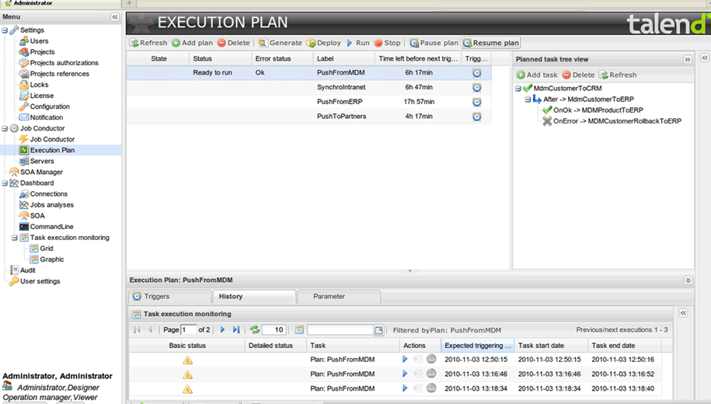
Deployment ….
The Execution Plan feature helps you sequence and orchestrate the various Job executions and ease the error recovery, directly from the Job Conductor. The execution plan is a task-based feature that outlines dependencies among different tasks orchestrating the execution sequence. The task dependencies are defined through a hierarchical view of main and child tasks where each task can have a subordinate task.

Slide 20
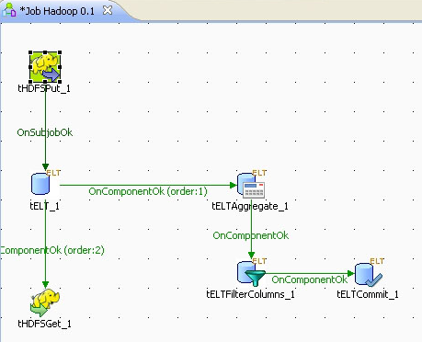
Deployment ….
Apache Hadoop is an open source Java software framework that supports data-intensive distributed applications. It leverage Map Reduce architecture and enables applications to work with thousands of nodes and peta bytes of data using large grid of inexpensive servers. Talend Enterprise Data Integration Big Data includes a native support for Hadoop making it possible to scale to any level and support any complex data type, so companies can leverage their Hadoop clusters for peak data volumes and complex transformations. A dedicated set of components available from the component Palette help read and write HDFS as well as Hive systems and include ELT and SQL template features.

Slide 21
Monitoring
Topics | Talend Open Studio for Data Integration | Talend Integration Studio for Data Integration
AMC | NO | YES
Dashboard | NO | YES
Error Recovery | NO | YES

Slide 22
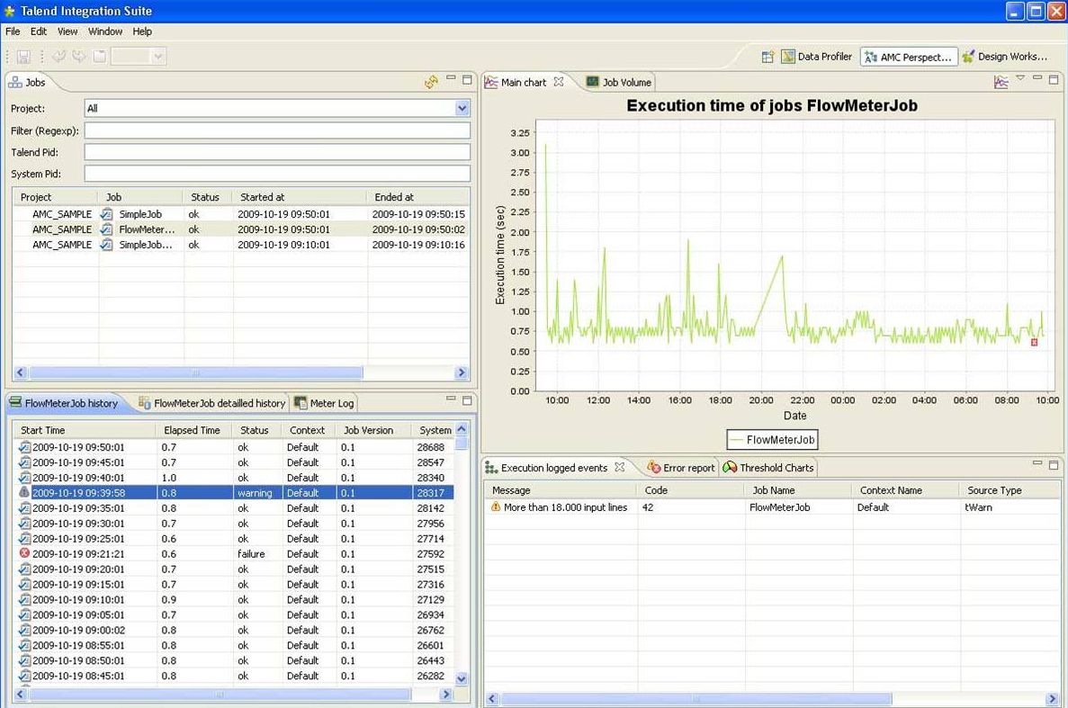
Monitoring
Talend Activity Monitoring Console is a convenient graphical interface and a centralized supervising tool. It provides detailed monitoring capabilities that can be used to consolidate the collected log information. The Activity Monitoring Console monitors job events (successes, failures, warnings, etc.), execution times and data volumes through a single console from a centralized point.
Copyright © 2014 by Vikram Takkar. All Rights Reserved..

Slide 23
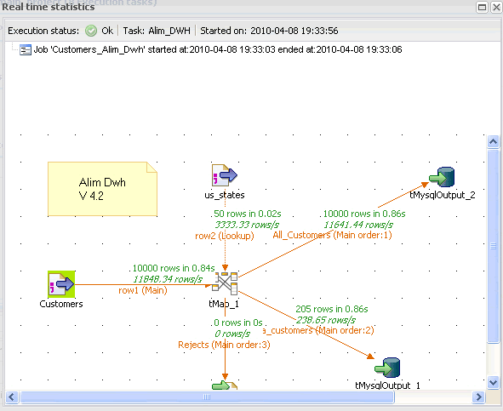
Monitoring…
The Dashboard is a Web-based version of the Activity Monitoring Console that can be accessed easily through a Web browser. The Dashboard provides execution performance diagrams and status indicators, enabling any stakeholder to view both the current and historical status of any integration process execution. It also provides detailed monitoring capabilities that can be used to consolidate log information collected, understand the underlying component and job interaction, provide task execution information in a timely manner, prevent faults that could be unexpectedly generated, support the system management decisions.

Slide 24
Monitoring…
Error Recovery - Job execution processes can be time-consuming, as are backup and restore operations. Talend Enterprise Data Integration Studio includes a recovery checkpoint capability that is set up at Job design time. In case of failure, processes can be resumed from one of the checkpoints. Job developers can also design and integrate specific error management in response to specific error conditions using the checkpoint "on-failure" instruction function. Recovery checkpoints can be appropriately initiated at specified intervals of the data flow (on trigger connections). The purpose of it is to minimize the amount of time and effort necessary when a Job execution process needs to be restarted due to a failure. With the help of the error recovery checkpoint feature, the process can be restarted from the latest checkpoint prior to the failure (or any other checkpoint before the failure occurred), rather than from the beginning of the Job execution process.
Copyright © 2014 by Vikram Takkar. All Rights Reserved..

Slide 25
Questions?
Copyright © 2014 by Vikram Takkar. All Rights Reserved..

